Slide 1
Welcome Back!
MATH 4341 : Linear Algebra
Aashnan Rahman
Junior Lecturer
Department of Computer Science and Engineering (CSE)
Islamic University of Technology

Slide 2


Slide 3
A bit of DLD

Slide 4
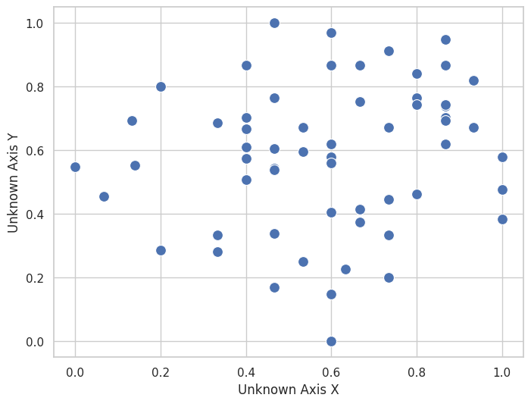
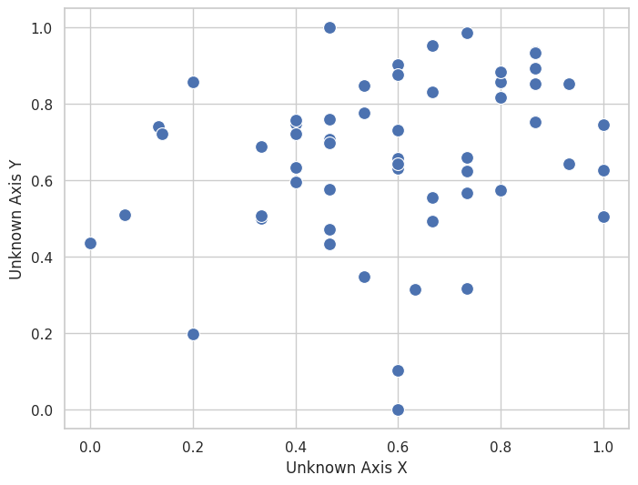
What might this be?

Slide 5
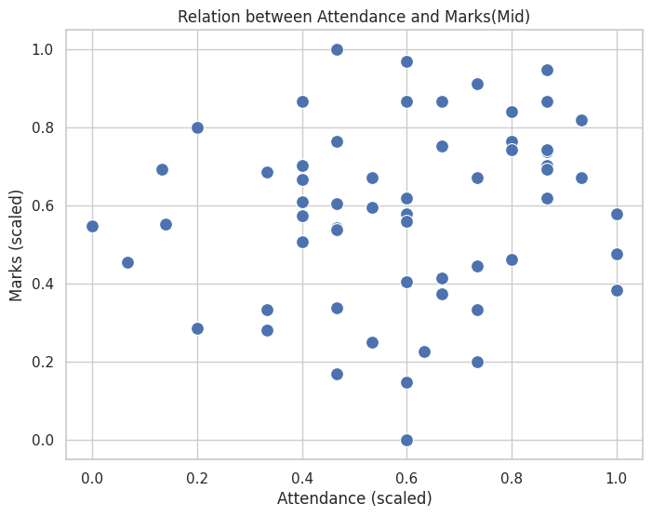
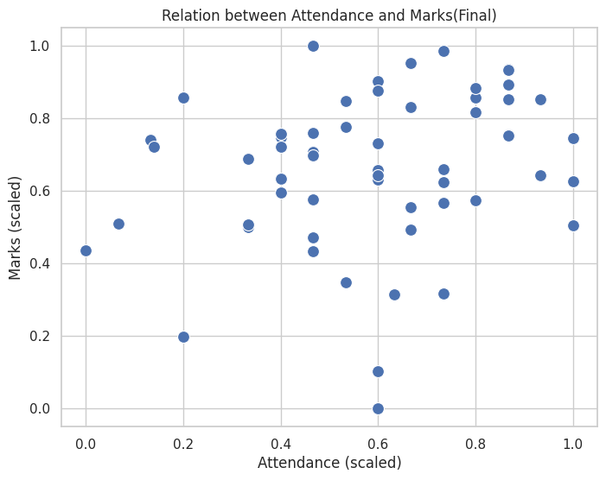

Slide 6
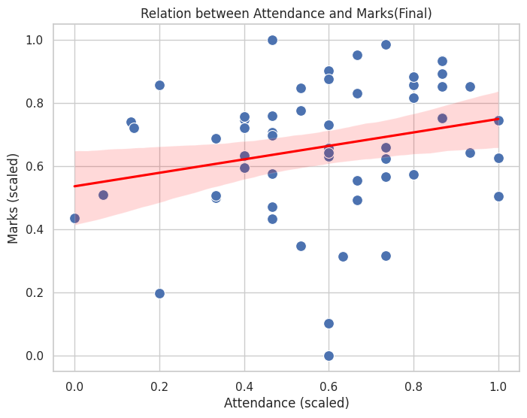

Slide 7
Why are we need to study
Linear Algebra?

Slide 8
Have you heard these words?
COMPUTER GRAPHICS
DATA SCIENCE
COMPUTER VISION
MACHINE LEARNING
DEEP LEARNING
COMPUTER NETWORKS

Slide 9
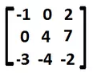
What are we dealing with?
2i + 3j
Vectors
Matrices

Slide 10

Solving Linear Equations
Solve this !!
3a + 2b + 4c + 7d + 9e + f = 1
12a + 5b + 2c + 9d + 8e + 3f = 11
−a + 2b + 7c − 3d + 4e + 2f = 8
7a − b + 3c − 5d + 2e + 6f = −2
−4a + 6b + c − 2d + 9e − 3f = 4
4a − 2b + 11c − 6d + 8e + 2f = 8
3x + 2y = 7
4x + 5y = 9
Easyyyyy

Slide 11
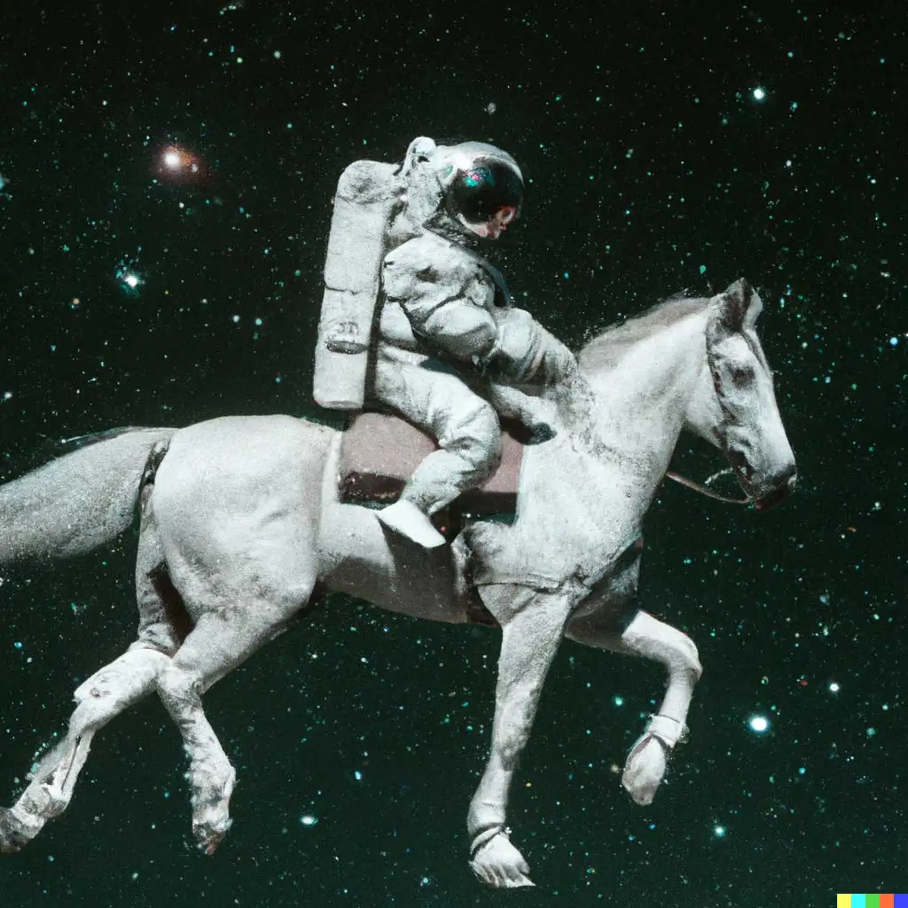
DALL·E
“A photo of an astronaut riding a horse.”
source

Slide 12
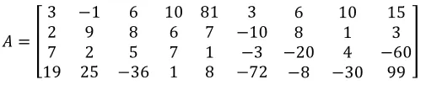
DALL·E
“A photo of an astronaut riding a horse.”
01001………1010101……….110010101
*Some complicated mathematical operations*

Slide 13

Image Rotation

Slide 14
—Gilbert Strang
“Linear algebra is a tool for thinking. It's not just about vectors and matrices; it's about understanding the underlying structures and patterns.”

Slide 15
Resources
Google Classroom : cqn2akqm
Drive Link : https://drive.google.com/math4341
Lecture Playlist : Gilbert Strang
For Visualization : 3 blue 1 brown

Slide 16
Classroom Code
cqn2akqm

Slide 17


Slide 18

¡THANKS!

